Slide 1
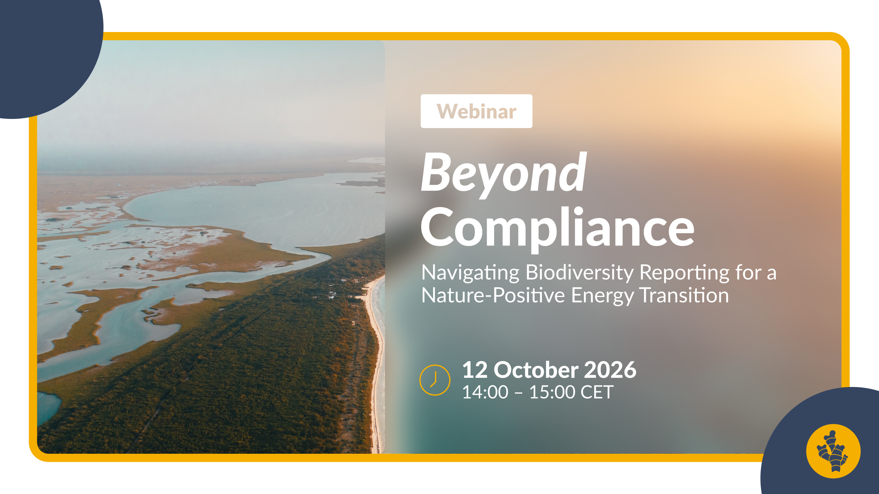

Slide 2


Housekeeping
MODERATOR
Camera on, microphone off​​.
Rename yourself to “Name, Organisation”​​
If you have a question, raise your hand​ or write them into the chat.
Please ask your questions during the Q&A.
This session is being recorded.
Annika Lilliestam
Coordinator - GINGR
Renewables Grid Initiative

Slide 3
Welcome
Please use the chat to briefly indicate your institution and country of residence or work.

Slide 4


Our Speakers
Gus Schellekens
Director – GINGR
Renewables Grid Initiative
Claire Weller
Technical Director – Sustainable Infrastructure
The Biodiversity Consultancy

Slide 5
Today’s Agenda
14:00 CET 15:00 GMT | Welcome & Introduction to GINGR by Annika Lilliestam (GINGR)
14:05 CET 15:05 GMT | Introductory remarks by Gus Schellekens (GINGR)
14:15 CET 15:15 GMT | The Nature-Positive Navigator by Claire Weller (TBC) Tool structure Methodology Intended Use
14:35 CET 15:35 GMT | Navigator user case by Claire Weller (TBC)
14:40 CET 15:55 GMT | Moderated Q&A with the audience
14:55 CET 15:55 GMT | Next Steps / Wrap-Up by Annika Lilliestam (GINGR)

Slide 6
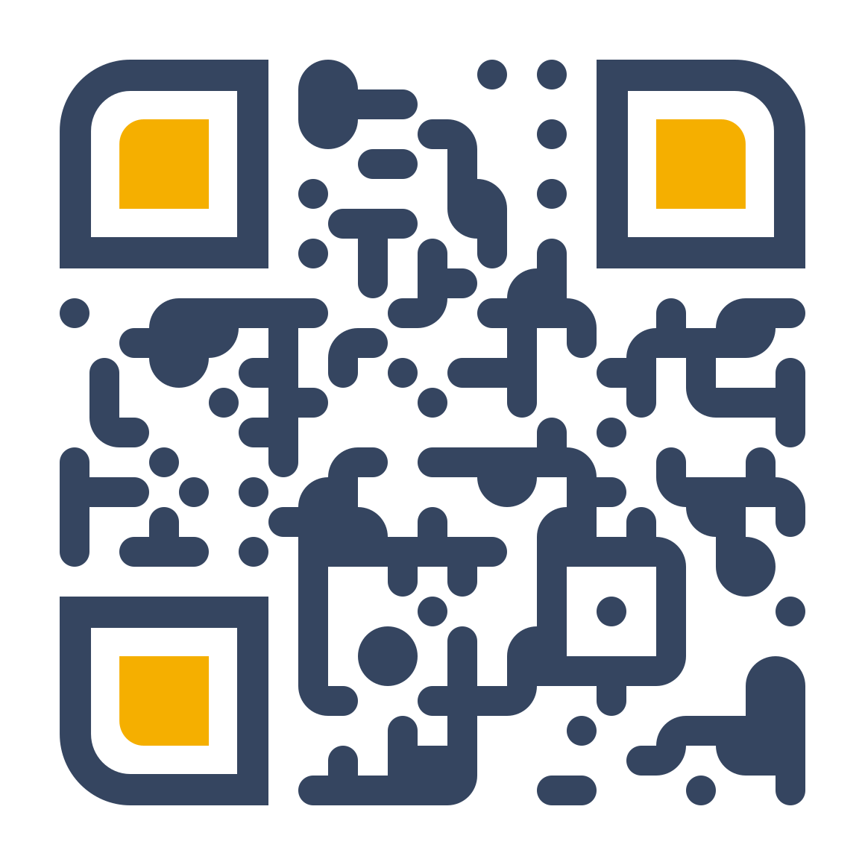


Global Initiative for Nature, Grids, & Renewables
We envision a rapid energy transition enabled by wind, solar and electricity grids that embraces Nature- and People-Positive goals.
Our Mission
GINGR aims to support the just and sustainable energy transition by providing assessment tools to quantify contributions to Nature- and People-Positive goals.
To facilitate this, we intend to develop monitoring and reporting systems that are globally aligned and standardised.
gingr.org
an initiative by

Slide 7
Introduction to the Nature-Positive Navigator
Notes:
Thanks Annika and Gus for having me and everyone for joining today. Before I start, I wanted to acknowledge my colleague Paris Stefanoudis who was instrumental in bring this framework to life; thank you Paris for your hard work and for joining us today to support with any questions this presentation may bring.
Over the next 20 minutes, I will introduce the Nature-Positive Navigator, explain why it was developed, what it can help organisations do, and how it can support nature-positive decision-making in practice.
Many organisations have made commitments relating to biodiversity and nature-positive outcomes, but the challenge is often moving from ambition to consistent action. On the other hand, project teams are asking how can they meet multiple reporting and stakeholder expectations without creating unnecessary complexity for their project.
he Navigator was developed to help answer those questions. I'll first walk through what the Navigator is and how it works, and then we'll look at a practical example of how the framework may be used on a renewable energy project.

Slide 8
What is the Nature-Positive Navigator?
Engage • Strengthen • Communicate
Nature-positive outcomes
Renewable energy and grid
Tiered maturity framework • Clear actions • Practical guidance
Reporting • Regulation • Permitting
Notes:
One of the challenges we hear repeatedly is that there's no shortage of commitments, reporting frameworks or guidance documents. The real difficulty is connecting these high-level expectations with the decisions organisations make every day on portfolios and projects.
The GINGR Nature-Positive Navigator has been thought as a practical, flexible tiered maturity framework designed for renewable energy and grid companies to engage, strengthen and communicate their nature-positive journey.
It provides a structured way to understand where you are today, identify where improvement is needed, and prioritise practical actions that can contribute to Nature-Positive outcomes.
he Navigator is not another reporting framework. It has been designed to provide clear guidance to assist organisations navigate the reporting, regulatory and permitting landscape relevant to renewable energy infrastructure.

Slide 9
A tiered maturity framework across six focus areas
Nature-Positive Outcomes
The Nature-Positive Navigator provides a practical maturity pathway for embedding actions that support Nature-Positive outcomes across six focus areas:
Innovator
1. Governance
4. Nature Outcomes
Organisational integration
Practitioner
2. Strategy
5. Stakeholder Participation
3. Risk Management
6. Social Principles
Explorer
Maturity
Notes:
The Navigator is built to follow organisations are their Nature-Positive journey.
The framework covers six focus areas that collectively influence Nature-Positive outcomes, ranging from governance and strategy to stakeholder participation and social principles.
Rather than treating nature-positive performance as something you either have or don't have, the Navigator recognises that maturity develops over time, and often at different speeds across different parts of a business. For example, governance systems may be relatively advanced, while stakeholder participation is still developing.
To reflect the progressive integration of nature-positive considerations into business decisions, the Navigator reflects three maturity tiers: Explorer, Practitioner and Innovator.
The purpose isn't to label organisations, but rather help identify the next realistic step that will most effectively strengthen performance and outcomes based on a specific company or project’s context.

Slide 10
Poll #1
What do you consider your company’s maturity starting point to be?
Notes:
Before we go further, I'd like to get a sense of who's in the room.
Thinking about your organisation's approach to nature, and using the three levels of maturity of the framework: explorer, practitioner or innovator, where would you say you currently sit on this journey?

Slide 11
Why industry stakeholders asked for this Navigator
Developers, financial institutions and NGOs consistently highlighted the need for: Practical improvement pathway Clear reporting navigation Reporting-to-action links Framework mapping Evidence reuse Reduced duplication Implementation tools and guidance The Nature-Positive Navigator was developed to respond directly to these needs
Notes:
When we first engaged with developers, financial institutions and NGOs in the early phases of the project, we got a clear message: the challenge isn’t the lack of framework; organisations were already dealing with many frameworks, requirements, information requests.
Rather, there was a consistent need for clarity, practical ways to identify and implement improvements, clearer links between reporting requirements and implementation actions, and ways to avoid collecting the same evidence multiple times for different purposes.

Slide 12
Benefits for companies
Challenge companies face
Complex disclosure requirements
Good-practice clarity
Action prioritisation
Cross-team alignment
Value and outcomes
How the Navigator helps
Unified requirements • Overlap mapping • Evidence reuse • Reduced reporting
Six-area pathway • Maturity assessment • Good-practice benchmark
Improvement opportunities • Next steps • Examples and evidence • Implementation guidance
Shared approach • Embedded governance • Nature-led decisions
Gap analysis • Progress tracking • Investment case • Adaptive management
Notes:
In responding to these needs, the Navigator provides key benefits for companies using it:
Instead of approaching reporting, permitting, lender requirements and internal improvement initiatives separately, organisations can use one framework to support all of them.
Another important benefit is prioritisation. The Navigator helps identify where effort is likely to have the greatest impact based on the level of maturity of the organisation and context.
It also enables cross team alignment. Sustainability teams, permitting teams, environmental specialists and project managers often work through different objectives and processes. The Navigator helps align teams around a shared understanding of good practice.
The aim is not simply better reporting, but rather more effective decision-making to achieve nature-positive outcomes. The Navigator helps organisations identify performance gaps, track progress against targets and justify investment in nature where greatest value can be achieved.

Slide 13
What the Navigator IS NOT
A new reporting standard
A certification, verification or assurance mechanism
A replacement for regulatory compliance and lender due diligence
A basis for claiming nature-positive outcomes
A prescriptive, one-size-fits-all process
A detailed library of every reporting framework and technical methodology
Notes:
It's also important to be clear about what the Navigator isn’t.
Not a new reporting standard or an additional set of mandatory disclosure requirements
Not a certification, verification or assurance mechanism, and does not provide a corporate score
Not a replacement for regulatory compliance, permitting, lender due diligence or existing external assurance processes
Not a label to claim to be nature-positive because a particular tier is reached
Not a prescriptive, one-size-fits-all process, context is important.
Not a detailed library of every reporting framework, metric or technical methodology

Slide 14
How to use the Navigator
Notes:
Now that we've covered the fundamentals, let's look at how organisations can use the Navigator in practice.

Slide 15

User journey
7. Communicate Outcomes
5. Implement Actions
1. Understand Context
6. Monitor Progress
2. Identify Relevant Requirements and Frameworks
4. Develop Improvement Plan
Do
Check
Act
Plan
3. Assess Current Position
Overarching Activities:
Stakeholder participation
Adaptive management
Learning and feedback loops
Notes:
The user journey follows a continuous-improvement process, you may already be familiar with: plan, do, check, act.
I am going to walk you through step by step. But what's important to remember is that the Navigator is flexible and organisations don't need to start at the beginning every time.
Some may already have strong baseline information and start at the assessment step. Others may be preparing for a permitting process and begin with the identify step.
First step of the Navigator is
1. Understanding the Context
This is about gathering existing information: Project type, geography, existing project experience, available baseline information and relevant local data sources.
For example, a company beginning its Nature-Positive journey may start at Step 1: Understand Context.
Second step is:
2. Identifying Relevant Requirements and Frameworks
This is about identifying applicable regulatory, lender, voluntary disclosure frameworks, together with relevant organisational policies, standards and commitments.
For example, a project team preparing for permitting may start at Step 2: Identify Relevant Requirements and Frameworks.
Step 3 is:
3. Assessing Current Position
The Navigator includes a self-assessment step against six focus areas, including assessing current performance against key themes, what evidence is already available, and what are the priority dependencies, impacts, risks and opportunities.
For example, a company with existing reporting requirements may start at Step 3: Assess Current Position.
Next step is
4. Developing an Improvement Plan
This step is about Prioritising actions, identifying capability gaps and defining project and organisational improvement measures.
Then comes the
5. Implementation of Actions
This is where priority actions are implemented across different focus areas, including governance, strategy, risk & impact management, monitoring and stakeholder participation.
Then,
6. Monitoring Progress
This step is about evidence collection, monitoring, implementing adaptive management, learning and continuous improvement.
A company seeking to strengthen its performance may focus on Steps 4-6.
And final step,
7. Communication of Outcomes
This step consists of conducting Internal and external reporting, disclosures, stakeholder communications, and identifying lessons that inform future assessment and planning.
An important point to highlight is that stakeholder engagement, adaptive management and learning sit across the whole process. They are relevant at every stage and help ensure improvements remain grounded in real-world experience.
Now that we've seen how a user might move through the Navigator, let's look at how progress is described and measured.
One important concept to keep in mind is that becoming nature-positive is a process of gradually building capability, embedding good practice, and learning from experience.

Slide 16
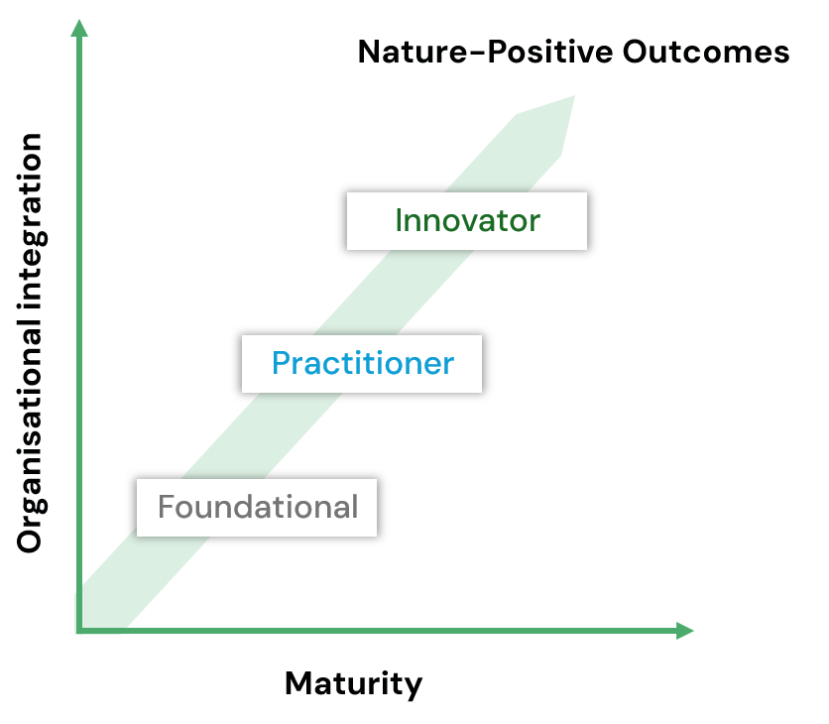
Understanding tier progression
Likely company profile
What companies gain
Sector leader
High influence and capacity
Shaping the Nature-Positive agenda
System-level change
Reputational leadership
Proven outcomes
Sector influence
Nature-Positive Outcomes
Innovator
+
+
Organisational integration
Practitioner
Public Nature‑Positive commitments
Investor-led action
Voluntary nature reporting
Nature integrated into decisions
Demonstrated implementation
Stakeholder confidence
Explorer
+
+
Maturity
Early Nature-Positive engagement
Foundational understanding and communication of nature-related issues
Stronger reputation
Notes:
That's why the Navigator has been structured around three maturity levels, helping organisations understand where they are today and what the next realistic step looks like.
These maturity tiers represent progressive integration of nature considerations into organisational decision-making.
CLICK
Explorer is about building awareness and basic capability.
CLICK
Practitioner is where we start seeing systematic implementation and integration into routine business processes.
CLICK
Innovator is where organisations are demonstrating leadership, influencing wider practice, and showing evidence of broader outcomes.
The tiers provide a structure for assessing progress, but they're not intended to be used as a simple checklist or one-off scoring system.
To ensure the framework is applied consistently and appropriately, the Navigator is underpinned by a set of guiding principles.

Slide 17
Key Principles
01
02
03
04
05
Additive progression
Evidence-based progression
Continuous improvement
Different maturity tiers across focus areas
Context matters
Notes:
These principles are what make the maturity tiered approach practical and flexible, helping users apply it consistently while recognising that every organisation's journey will be different.
First, progression is additive. Good practice established at Explorer level should be maintained and built upon at higher levels.
Second, it's evidence-based. What matters is implementation, not simply commitments or policies.
Third, the value comes from continual improvement, not from achieving a particular label. So as new evidence is gathered, assessment can be updated to identify new maturity level.
Fourth, progression is not linear and organisations are not necessarily don't need to reach the same level of maturity across all focus areas.
And finally, context matters. Expectations for a large multinational developer and a smaller project developer may be different; similarly, expectations would differ between regions and project types.
The Navigator provides structure, but it still allows room for professional judgement and context-specific application.

Slide 18
Applying the Navigator in practice
Notes:
Now we’ve covered the basis of the Navigator itself, let’s look at how these concepts translate into practice.
Before we continue, I just wanted to highlight another important aspect of the Navigator: it isn't designed to be used by corporate sustainability teams, and it's not just a project tool either.
It's intended to work across both levels.
In fact, the Navigator is aimed at translating high-level biodiversity commitments into tangible actions on the ground, clearly mapping how project-level activities and organisational-level commitments fit together within the regulatory, permitting and reporting landscape.

Slide 19
Project and organisational relevance
Focus area | Primary application level
#1 Governance | Organisation
#2 Strategy | Organisation
#3 Risk & Impact Management | Both
#4 Nature Outcomes, Metrics & Monitoring | Both
#5 Stakeholder Participation | Project
#6 Social Principles | Project
Key: Project = Organisation =
Notes:
One of the challenges we often see is that nature-related ambitions are set at a corporate level, while implementation happens through individual projects. As a result, there can sometimes be a disconnect between what an organisation says it wants to achieve and what project teams are actually equipped to deliver. Similarly, commitments are made at organisation level, but the evidence demonstrating progress is often generated at project level.
The Navigator was designed with that challenge in mind. The Navigator is structured around 6 focus areas – Governance, Strategy, Risk&Impact Management, Nature Outcomes, Metrics and Monitoring, Stakeholder Participation and finally Social Principles.
Some elements, such as governance and strategy, naturally sit at a corporate level. Others, such as stakeholder engagement, mitigation, monitoring and adaptive management, are often delivered through projects.
However, neither level can work effectively towards Nature-Positive outcomes in isolation. Although strong corporate commitments are needed to translate into project actions, it is important to recognise that projects are where many of the opportunities and risks for nature actually materialise. That's where decisions are made, costs and benefits are considered, and outcomes are measured.
So, while the framework supports strategic thinking at an organisational level, it is equally relevant for the teams planning, delivering and operating projects on the ground, understanding where actions can deliver most effectively nature-positive outcomes.
Let's now look at some of the specific focus areas and see what progression through the maturity tiers looks like in practice.

Slide 20
Focus Area #1: Governance
Primary focus area relevance
Key: Project = Organisation =
Accountability
Governance Processes
Compliance & Reporting
Decision-Making
Good Practice Criteria
Good Practice Criteria
Good Practice Criteria
Good Practice Criteria
Innovator
Executive and/or Board oversight of nature outcomes established
Governance enables impact beyond boundaries
Governance streamlines multi-framework reporting through shared information
Nature considerations influence strategic and investment decisions
+
+
+
+
Practitioner
Nature-related responsibilities embedded in governance structures
Applied consistently across projects and business units
Governance processes support reporting across applicable frameworks
Nature considerations influence operational decisions
+
+
+
+
Explorer
Reporting responsibility assigned
Governance responsibilities documented
Compliance and reporting obligations identified
Nature issues considered in relevant decisions
Illustrative Evidence Organogram; Named reporting lead; Governance roles and responsibilities; RACI matrix
Illustrative Evidence
Governance procedures; Decision logs; Management review records
Illustrative Evidence
Compliance register; Framework register; Reporting roadmap
Illustrative Evidence
Investment committee papers; Business cases; Strategic planning documentation
Notes:
Let's start with governance. In practice, governance is about who makes decisions, who is accountable and how information influences those decisions. In the context of the Navigator, it is also asking ‘How are nature-related risks and opportunities considered when decisions are made?’
Looking across the maturity levels, the targeted progression is about better integration and accountability.
At the Explorer level, organisations are typically developing awareness and establishing initial commitments. Nature may be recognised as important, but roles, responsibilities and decision-making pathways are still emerging.
At the Practitioner level, governance becomes more systematic. Responsibilities are clearly assigned, nature-related considerations are incorporated into planning and decision-making processes, and there are defined mechanisms for oversight and review.
At the Innovator level, accountability becomes fully embedded within the organisation. Nature-related performance is actively considered alongside other strategic business priorities, leadership demonstrates visible ownership, and lessons learned are routinely fed back into decision-making.
CLICK
One element I would highlight is accountability. Organisations may have strong policies and ambitious commitments, but when there is no clear responsibility for delivering those commitments, progress can be slow or inconsistent.
Embedding nature-positive considerations into all levels of governance ensures that nature-positive outcomes are not simply the responsibility of environmental specialists, but are understood and supported by decision-makers across the organisation.
Let’s talk through a concrete example:
Baseline surveys identify a potential risk of collision to a protected bird species. The environmental specialist may recommend changes to turbine layout, seasonal restrictions, or enhanced monitoring.
Governance is what supports answering some critical questions: Who reviews those recommendations? Who decides whether they are implemented? Who is accountable if commitments made during permitting are not delivered during construction or operation?
At a lower level of maturity, those responsibilities may be unclear, leading to delays, inconsistent decisions or gaps between commitments and implementation. No change to layout, no seasonal restrictions planned.
At a higher level of maturity, responsibilities are clearly defined. Project managers understand their role, environmental leads have clear escalation pathways, senior leadership receives appropriate information, and accountability for delivering biodiversity commitments is embedded within project governance structures.
The result is better decision-making and greater confidence that commitments made on paper are actually delivered on the ground.

Slide 21
Focus Area #4: Nature Outcomes, Metrics & Monitoring
Primary focus area relevance
Key: Project = Organisation =
Baseline Understanding
Monitoring Design
Metrics & Indicators
Targets
Good Practice Criteria
Good Practice Criteria
Good Practice Criteria
Good Practice Criteria
Innovator
Baselines support long-term outcome evaluation
Monitoring drives management
Metrics demonstrate outcomes and co-benefits
Targets linked to long-term Nature-Positive outcome ambitions
+
+
+
+
Practitioner
Baselines reviewed and updated where required
Monitoring linked to objectives, management actions and BAPs
Assess effectiveness of mitigation and enhancement measures
Targets established and reviewed
+
+
+
+
Explorer
Baseline conditions established proportionate to priority risks & impacts
Monitoring and measurement approaches established
Biodiversity, ecosystem services & social metrics and indicators identified
Monitoring commitments documented and aligned with permitting
Illustrative Evidence
Baseline surveys; Biodiversity studies; Ecosystem assessments; Social baseline assessments
Illustrative Evidence
Monitoring plans; Monitoring frameworks; Biodiversity Action Plans; Adaptive management plans
Illustrative Evidence
Indicator frameworks; Monitoring reports; Biodiversity trend analyses; Outcome dashboards
Illustrative Evidence
Target registers; Performance tracking systems; Nature-related objectives; Strategic targets
Notes:
Let’s look at another focus area of the Navigator: Nature Outcomes, metrics and monitoring
This is effectively asking: how do we know whether our actions are actually delivering the outcomes we intended?
Many organisations already undertake some form of environmental monitoring, often to meet permitting or compliance requirements. However, monitoring alone does not necessarily tell us whether we are achieving positive outcomes for nature.
The emphasis of this focus area is moving organisations on a Nature-positive journey from monitoring as a compliance exercise towards monitoring as a strategic management tool.
At the Explorer level, organisations typically establish baseline information and track a limited number of indicators, often driven by regulatory requirements.
At the Practitioner level, monitoring programmes become more structured and are explicitly linked to project objectives, mitigation measures and expected outcomes.
At the Innovator level, monitoring is integrated into adaptive management processes. Results are regularly reviewed, lessons learned inform future decisions, and data is used to continuously improve outcomes over time.
Data isn't collected simply to satisfy a permit condition. It's used to understand what's working, what isn't working, and where changes are needed to improve outcomes.
CLICK
One aspect I would particularly highlight is monitoring design.
A well-designed monitoring programme starts by asking what decision the data needs to support.
Monitoring programmes collect large amounts of data for a range of reasons, some because it has always been done that way, without considering how that information will actually be used.
The Navigator encourages organisations to work backwards from the desired outcome and identify the indicators, methods and timescales needed to understand whether progress is being achieved.
The aim is to generate credible evidence that those actions are contributing to better outcomes for nature.
If we go back to our earlier example,
Following impact assessment, the project introduces mitigation measures to reduce collision risk for a sensitive bird species.
At a lower level of maturity, monitoring might focus primarily on demonstrating that the mitigation measure was implemented, for example confirming that seasonal restrictions or operational controls were applied as required.
At a higher level of maturity, the monitoring programme would be designed to answer a much more important question: did those measures actually reduce risk for the species?
This could involve measuring bird activity, flight behaviour, habitat use or population trends over time, depending on the project's objectives and the available evidence.
The results are then reviewed and used to determine whether the mitigation is working as expected or whether adjustments are needed.

Slide 22
Focus Area #5: Stakeholder Participation
Primary focus area relevance
Key: Project = Organisation =
Stakeholder Understanding
Access to Information
Dialogue and Collaboration
Stakeholder Influence
Good Practice Criteria
Good Practice Criteria
Good Practice Criteria
Good Practice Criteria
Innovator
Stakeholder networks integrated into strategic planning
Stakeholders co-produce information, evidence and monitoring data
Shared ownership, co-design or partnership approaches explored
Stakeholders actively shape decisions and outcomes
+
+
+
+
Practitioner
Stakeholder mapping regularly reviewed and updated
Accessible information and dialogue mechanisms established
Collaborative participation and feedback mechanisms established and acted upon
Stakeholders influence key project decisions
+
+
+
+
Explorer
Relevant stakeholders identified
Relevant information made available to stakeholders
Opportunities provided for participation, discussion and questions
Stakeholder views considered in decision-making
Illustrative Evidence
Stakeholder maps; Stakeholder registers; Stakeholder analyses
Illustrative Evidence
Information portals; Engagement materials; Disclosures records; Grievance mechanisms
Illustrative Evidence
Consultation records; Partnership agreements; Meeting records; Community monitoring programmes
Illustrative Evidence
Decision records showing stakeholder input; Feedback logs; Participation reports; Co-design documentation
Notes:
"The third focus area I wanted to highlight today is Stakeholder Participation.
This focus area looks at how organisations engage with stakeholders and how stakeholder perspectives are incorporated into planning, decision-making and implementation.
As organisations progress through the maturity levels, engagement evolves from informing stakeholders, to consulting stakeholders, and ultimately to creating opportunities for meaningful participation and collaboration.
At the Explorer level, organisations are primarily focused on identifying stakeholders and sharing information.
As maturity develops, participation becomes more meaningful.
The question shifts from 'Have we consulted stakeholders?' to 'Have stakeholders influenced decisions?
At the highest level of maturity, organisations increasingly work with stakeholders as partners in generating knowledge, monitoring outcomes and shaping future actions.
CLICK
One aspect I would particularly highlight is access to information.
Meaningful participation can only happen when people have access to the information they need to understand potential impacts, opportunities and proposed actions.
If stakeholders receive incomplete information, receive it too late, or receive it in a format that is difficult to access or understand, their ability to contribute effectively becomes limited.
Access to information is about ensuring information is transparent, understandable, timely and appropriate for the intended audience.

Slide 23
Navigator User Case
Notes:
Now we’ve covered the theory, let’s look at a hypothetical project example and see how the Navigator might actually be applied in practice, to give you a much more tangible sense of how the framework can support day-to-day decision-making and continuous improvement over the life of a project.

Slide 24
Seabreeze uses the Navigator to turn Nature-Positive ambition into action
HYPOTHETICAL EXAMPLE
1 GW
A sensitive, shared environment
• Benthic habitats
• Migratory seabirds
• Commercial fishing activity
Offshore wind project
FOUNDATIONS ALREADY IN PLACE
Environmental assessment
Permitting
Stakeholder engagement
WHY USE THE NAVIGATOR?
01
Assess current
maturity
02
Prioritise
improvements
03
Guide
implementation
Notes:
We'll use a fictional offshore wind project to illustrate how a company might work through the Navigator and generate meaningful actions and outcomes.
Our example project, Seabreeze, is a large offshore wind development operating in a sensitive marine environment.
The project already has already acquired environmental permits and engaged with stakeholders in place, but wants to better understand its nature-positive maturity and identify opportunities for improvement.

Slide 25
Navigator Steps 1-2: Understand and Identify
Do
Check
Act
Plan
1. Understand Context
Key outputs ● Baseline ecology review ● Stakeholder analysis ● Social baseline review ● Priority DIRO register ● Initial risk and opportunity register
2. Identify Relevant Requirements and Frameworks
Key outputs: ● Compliance register ● Framework register ● Reporting roadmap
Lesson learned: Reuse existing evidence wherever possible
Notes:
Let's start at the beginning of the Navigator journey for the Seabreeze project.Before assessing maturity or identifying improvements, it's important to develop a clear understanding of the project's context. Every project operates within a unique environmental, social and regulatory landscape.
The project team begins by gathering information about the project, its biodiversity context, stakeholder landscape, existing commitments and relevant requirements.
This may include environmental assessment findings, biodiversity action plans, lender requirements, permit conditions, corporate commitments, monitoring data and stakeholder feedback.
In Step 2, that information is reviewed against existing requirements. In many organisations, valuable information already exists but is often spread across different teams, reports and management systems.
One of the benefits of these first two steps is bringing that information together in a structured way, creating a shared understanding across the project team.
The Navigator encourages the reuse of existing evidence. A single piece of evidence can often support multiple requirements. Identifying these overlaps with the Navigator reduces duplication and improves efficiency across mandatory and voluntary disclosure requirements.

Slide 26
Navigator Steps 3-4: Assess and Improve
Do
Check
Act
Plan
3. Assess Current Position
Focus area | Initial tier | Topic(s) | Key gap
Governance | Practitioner | Accountability; Decision-Making | Nature-related information not consistently informing strategic and investment decisions
Nature Outcomes, Metrics & Monitoring | Explorer | Monitoring Design; Targets | Monitoring focused on compliance rather than intended outcomes
Stakeholder Participation | Practitioner | Stakeholder Influence | Stakeholder influence on project decisions not consistently demonstrated
4. Develop Improvement Plan
Priority Action | Focus area / Topic | Lead Role | Evidence Expected
Establish executive accountability for biodiversity | Governance / Accountability | Sustainability Director | Organogram; RACI matrix
Develop outcome-focused monitoring programme | Nature Outcomes / Monitoring Design | Ecology Manager | Monitoring Framework
Strengthen stakeholder influence on project decisions | Stakeholder Participation / Influence | Stakeholder Engagement Lead | Consultation Records; Decision Logs
Notes:
Once that baseline understanding has been established, the next step is to assess maturity more systematically and identify where improvements could have the greatest impact.
As part of the assessing current position step, the project conducts a self assessment of its maturity in the 6 focus areas of the framework (we’ve only illustrated the 3 focus areas that we covered in the previous slides here), and identifies strengths, gaps and opportunities for improvement.
In our example, the assessment highlighted several strengths. The project has established biodiversity commitments, clear environmental management processes and a strong baseline understanding of potential impacts.
At the same time, the assessment identified opportunities for improvement.
Monitoring was still focused largely on compliance obligations rather than ecological outcomes. Stakeholder engagement is occurring regularly, but there are opportunities to strengthen how stakeholder input influenced decision-making. And while accountability exists, biodiversity performance is not yet being routinely discussed at senior leadership level.
In the Improvement plan development step, the objective is to identify actions that are achievable, relevant to project risks and opportunities, and likely to drive the most meaningful improvements.

Slide 27
Navigator Steps 5-6: Act and Monitor
Do
Check
Act
Plan
5. Implement Actions
Focus area | Topic | Action implemented | Evidence generated
Governance | Accountability | Biodiversity reporting lead appointed and executive oversight established | Organogram; RACI matrix
 | Decision-making | Nature risks incorporated into investment reviews | Investment committee papers; decision logs
Nature Outcomes, Metrics & Monitoring | Monitoring Design | Monitoring redesigned around project objectives and outcomes | Monitoring framework; Biodiversity Monitoring and Evaluation Plan
 | Targets | Outcome-focused biodiversity targets established | KPI dashboard; target register
Stakeholder Participation | Stakeholder Influence | Fisheries feedback incorporated into cable-routing decisions | Consultation records; feedback log
6. Monitor Progress
Examples of positive findings: Restored benthic habitat condition improved relative to baseline. Fisheries stakeholders reported fewer concerns following project modifications. | Examples of unexpected findings: Seabird monitoring had not yet demonstrated the anticipated response. Social monitoring showed participation in the community benefit programme, but insufficient evidence of longer-term outcomes.
Notes:
Once actions have been identified, and prioritised, the next step is to implement and start monitoring progress. The tool becomes a practical management tool, tracking implementation, evidence generated and contributions to nature-positive outcomes.
For governance, the project established clear accountability through a biodiversity reporting lead and executive oversight. Nature-related risks are also being considered within investment reviews and key project decisions.
For monitoring, the team has redesigned its monitoring programme around the outcomes it wants to achieve, rather than simply around permit requirements. At the same time, outcome-focused biodiversity targets have been established, creating a clearer link between management actions and expected results.
And for stakeholder participation, feedback from fisheries stakeholders has directly influenced cable routing decisions, demonstrating that engagement is contributing to project design rather than simply documenting opinions.
What's interesting is that not all outcomes emerge at the same pace.
Some improvements can be seen relatively quickly, particularly around governance and engagement – in the case of Seabreeze, fewer concerns reported from fishermen as initial concerns have been taken into consideration in project design.
Ecological outcomes often take longer, which is why adaptive management is an important part of the process – in the case of Seabreeze, seabird monitoring has not yet demonstrated the anticipated outcome. Rather than assuming an intervention is working, the project team can use monitoring results to review assumptions, adjust monitoring approaches, or explore additional actions where needed.

Slide 28
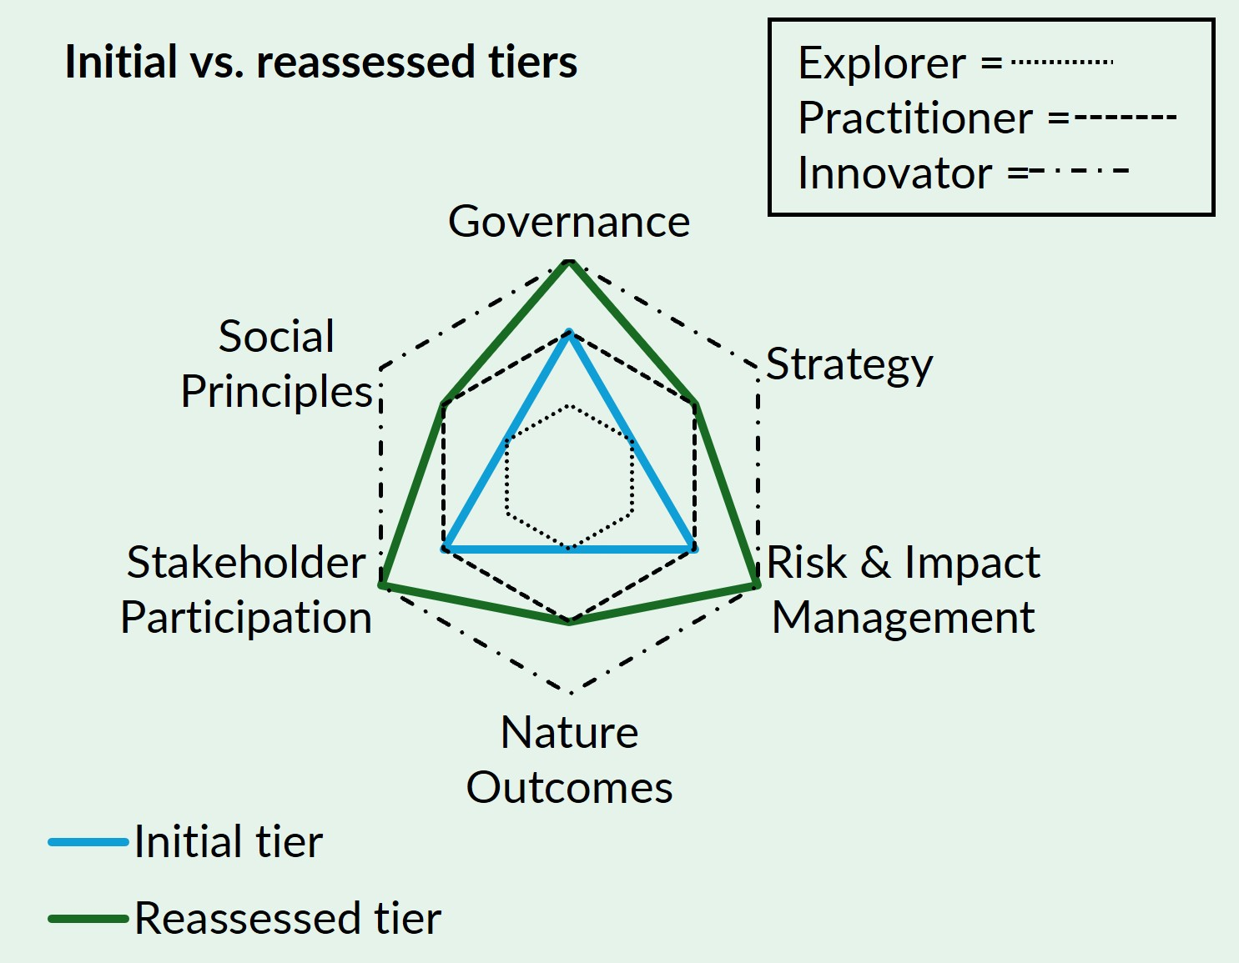
Navigator Step 7: Communicate
Reassessing maturity
7. Communicate Outcomes
Evidence generated through implementation and monitoring is used by Seabreeze Renewables to support:
Permitting and regulatory reporting
Lender communications
Internal governance reviews
Strategic planning
Future TNFD-aligned disclosure ambitions
Lesson learned: Communicate both progress and uncertainty, recognising that some ecological and social outcomes may take longer to emerge.
Notes:
The final step in the journey is communicating those findings, both internally and externally, and ensuring the evidence generated supports reporting, decision-making and continuous improvement.
One of the challenges many organisations face today is the growing number of nature-related reporting expectations. Project teams may be responding to lender requirements, regulatory commitments, sustainability reporting obligations, corporate KPIs, voluntary frameworks, and stakeholder requests for information.
The Navigator helps bring these different needs together by providing a structured way to organise evidence and communicate progress. The gathered evidence is also important for maintaining transparency about uncertainty and ongoing learning.
This is important as those lessons learned from one project can inform future projects, helping organisations avoid repeating mistakes and accelerating the adoption of good practice.
In our Seabreeze example, we can see that maturity for Governance, Risk & Impact Management and Stakeholder Participation progressed most rapidly because actions generated clear evidence of implementation and influence on decision-making – the project has moved from Practitioner to Innovator.
However Strategy, Nature Outcomes and Social Principles also progressed, but at a slower pace because evidence of long-term ecological and social outcomes takes time to emerge. In those areas, the Project has moved from Explorer to Practitioner.

Slide 29
What this illustrative example demonstrates
What this illustrative example demonstrates
Different tiers by focus area
Framework mapping identifies priority gaps.
Actions and evidence drive progress
Project delivery builds evidence
Monitoring and adaptive management
Evidence reuse reduces duplication.
Variable rates of progression
Better delivery strengthens biodiversity outcomes.
Innovator status not required everywhere
Notes:
So, as we've followed this example project through the Navigator journey, we've seen how the framework helps move from ambition to action, from action to evidence, and from evidence to learning.
This example highlights some key take-aways:
Companies may sit at different maturity tiers across different focus areas.
The Navigator helps identify priority gaps, actions and evidence needs across requirements.
Progression is driven by actions and evidence, not commitments alone.
Project-level implementation generates much of the evidence needed to strengthen organisational maturity.
Monitoring and adaptive management helps companies refine actions in response to new information, to deliver better outcomes over time
Reusing evidence across permitting, reporting and lender requirements can improve efficiency, reduce duplication and support more informed business decisions.
Different focus areas progress at different rates.
By focusing effort on priority actions, companies can contribute to stronger biodiversity outcomes.
It is not expected or necessary to reach Innovator tier across every focus area; the objective is continual improvement and more effective contribution towards Nature-Positive outcomes.
If there is one thing to take from today - the Navigator doesn't generate outcomes by itself. It is not about a one-off score or a label. It helps teams identify priorities, organise evidence, make better decisions and continuously improve to more effectively deliver biodiversity outcomes.

Slide 30
Poll #2
How useful do you think the Nature-Positive Navigator will be for your company?
Notes:
Follow up this question by asking people to provide feedback offline + asking companies to test the Navigator and lessons learned can be included as case studies in the Navigator.

Slide 31
Download the Nature-Positive Navigator Guidance

Slide 32

Thank you!
Join our Network:
https://www.gingr.org/newsletter
https://bit.ly/GINGR-on-LinkedIn

